Slide 1
DATA BUILD TOOL(DBT)

Slide 2
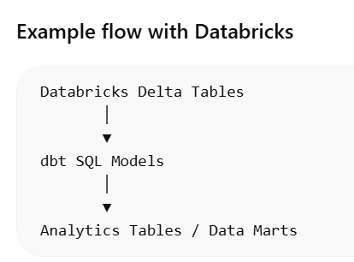
dbt (Data Build Tool) is an analytics engineering framework used to transform raw data in a data warehouse into clean, analytics-ready datasets using SQL.
Instead of moving data,
dbt runs SQL transformations
directly inside the warehouse like
Databricks, Snowflake, or Google
BigQuery.
Raw Data → dbt Transformations → Clean Analytics Tables

Slide 3
Key Features of dbt
1️⃣ SQL-Based Transformations
dbt allows data engineers and analysts to write pure SQL transformations.
SELECT
customer_id,
SUM(amount) AS total_revenue
FROM orders
GROUP BY customer_id

Slide 4
2️⃣ Modular Data Models
Each transformation is written as a separate SQL model file.
Example:
models/ stg_customers.sql stg_orders.sql city_revenue.sql
Models are connected using:
{{ ref('model_name') }}

Slide 5
3️⃣ Dependency Management
dbt automatically builds a DAG (Directed Acyclic Graph) of transformations.
Example pipeline:
customers_raw │ ▼ stg_customers │ ▼ customer_summary
dbt ensures correct execution order.

Slide 6
4️⃣ Incremental Processing
dbt supports incremental models to process only new data.
Example:
{{ config(materialized='incremental') }} SELECT * FROM orders {% if is_incremental() %} WHERE order_date > (SELECT MAX(order_date) FROM {{ this }}) {% endif %}
Benefits:
Faster processing
Lower compute cost

Slide 7
Components of dbt
1️⃣ Models
Core transformation SQL files.
Example:
models/stg_orders.sql
Creates tables or views in the warehouse.

Slide 8
2️⃣ Sources
Defines raw data sources.
Example:
sources: - name: raw schema: bronze tables: - name: customers
Used in models:
{{ source('raw','customers') }}

Slide 9
3️⃣ Seeds
Static data stored as CSV files and loaded into warehouse tables.
Example:
seeds/country_codes.csv
Run:
dbt seed

Slide 10
4️⃣ Snapshots
Used for Slowly Changing Dimensions (SCD Type 2).
Tracks historical changes.
Example:
snapshots/customer_snapshot.sql

Slide 11
5️⃣ Tests
Validate data quality.
Types:
Generic tests (unique, not_null)
Custom SQL tests

Slide 12
6️⃣ Macros
Reusable SQL logic written using Jinja templating.
Example:
{% macro calculate_discount(price) %} price * 0.9 {% endmacro %}

Slide 13
7️⃣ Documentation
dbt generates interactive documentation websites for your data models.

Slide 14
dbt Architecture
Raw Data Sources
│
▼
Sources (dbt)
│
▼
Staging Models
│
▼
Intermediate Models
│
▼
Mart / Analytics Models

Slide 15
dbt Project Structure
dbt_project/
│
├── models
│ ├── staging
│ │ stg_customers.sql
│ │ stg_orders.sql
│ │
│ ├── marts
│ │ city_revenue.sql
│
├── seeds
│
├── snapshots
│
├── macros
│
├── tests
│
└── dbt_project.yml

Slide 16
💡 In modern data platforms, dbt is often used with:
Databricks
Apache Airflow
AWS S3
to build end-to-end data pipelines.
AWS S3 / Kafka
│
▼
Delta Live Tables (Bronze → Silver)
│
▼
dbt Transformations (Gold Analytics)
│
▼
BI Dashboards

